Slide 1

Kher Wallet
Supervised by:
Dr. Khaled Wassif
TA. Ahmed Ali
Implemented by:
ID | Name
20186031 | Nada Mohamed
20186007 | Ayat Hany
20186008 | Sarah Khaled
20186043 | Mark Rofaeel
20186049 | Yasmine Shehab
Graduation Project
Academic Year 2021-2022
Midyear Presentation

Slide 2
TABLE OF CONTENTS
01
02
03
Project idea
Problem significance
Project specifications
Idea description and
domain of interest.
Problems to be solved.
Requirements and important diagrams.
04
05
06
Time plan
Demo
Conclusion
Tasks to be fulfilled.
Successive screenshots of our application.
Conclusion to what we have said.

Slide 3

Project idea
01
Idea description and
domain of interest.

Slide 4
Project idea
Nowadays, there are a lot of places that accept donations from different people.
It takes time and effort for people to reach out to such places, and people do not even know when they need such help.
So, our project idea is to solve this problem by implementing an application that help people to donate in an easier way and notify when there is an event nearby.

Slide 5
TABLE OF CONTENTS
01
02
03
Project idea
Problem significance
Project specifications
Idea description and
domain of interest.
Problems to be solved.
Requirements and important diagrams.
04
05
06
Time Plan
Demo
Conclusion
Tasks to be fulfilled.
Successive screenshots of our application.
Conclusion to what we have said.

Slide 6
Problem significance
02
Problems to be solved.

Slide 7
Problem significance
Our problem is that people spend so much time and effort to reach different places that has led to the shortage of the overall amount of donations.
Other problem is that those places do not have the capability to reach large amount of people to help in notifying them with events.
So, let’s imagine that there is an application that gather all these aspects together and that is what our application is going to do.

Slide 8
TABLE OF CONTENTS
01
02
03
Project idea
Problem significance
Project specifications
Idea description and
domain of interest.
Problems to be solved.
Requirements and important diagrams.
04
05
06
Time Plan
Demo
Conclusion
Tasks to be fulfilled.
Successive screenshots of our application.
Conclusion to what we have said.

Slide 9
03
Project specifications
Requirements and important diagrams.

Slide 10
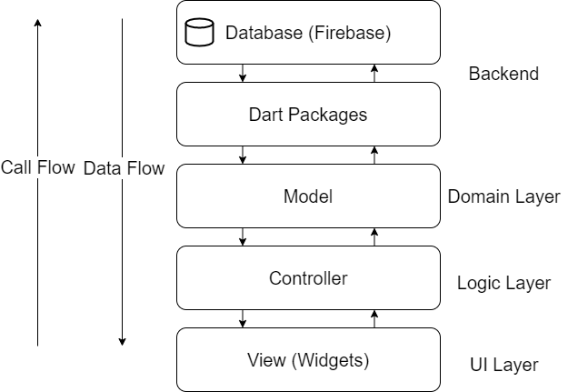
System architecture

Slide 11
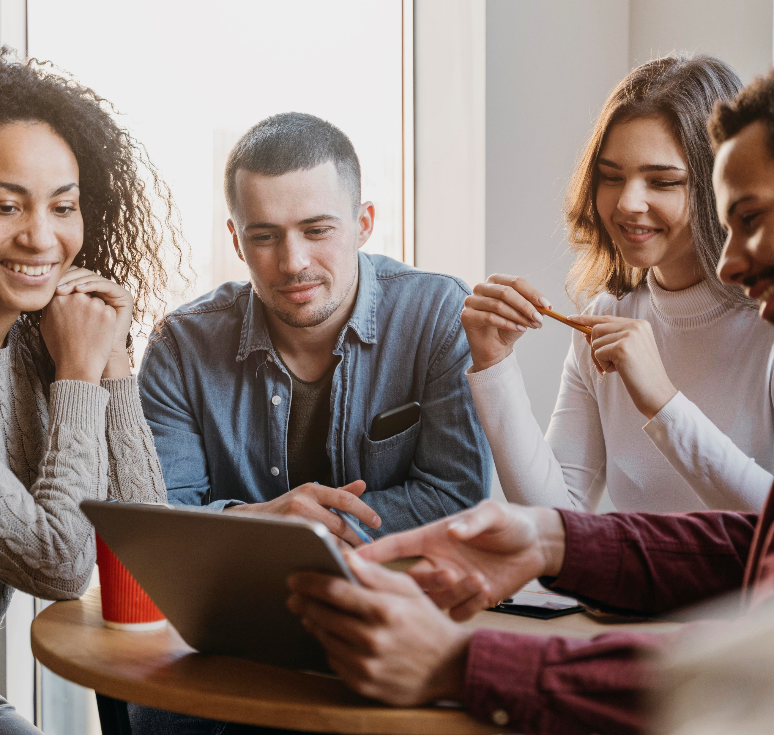

Stakeholders
Internal Stakeholders
External Stakeholders
Organizations (places’ owners).
Donators.
Developers.
Designers.
Testers.
Project managers.

Slide 12



Functional requirements
Donator’s functionalities
Sign up
Sign out
Using own information or by using Facebook or Google accounts.
At any given time, a donator can sign out.
Sign in
Using email and password.

Slide 13


Functional requirements
Donator’s functionalities
Update donator’s profile
View events
Any information in profile.
The upcoming events where help is needed.
View notifications
Whenever a new place is added, or when there is an event where help is needed.

Slide 14



Functional requirements
Donator’s functionalities
Expand event description
Search
About a specific event with full description.
Different places and events or categories.
Donate
Using credit card or by requesting a representative.

Slide 15



Functional requirements
Donator’s functionalities
View cart
Remove from cart
View different donations in cart.
Remove donations from cart.
Add to cart
Add donations to cart from same or different places.

Slide 16



Functional requirements
Donator’s functionalities
Write feedback
Contact us
Write a feedback of his own.
Contact us to solve any problem.
Request help
A ‘help’ section and frequently asked questions.

Slide 17


Functional requirements
Donator’s functionalities
Display places categories
Display donation categories
Which place category they want to explore from places categories.
Which donation type they want to explore from donation categories.
Select specific place
Select specific donation
Select specific place to view detailed information about it.
Select specific donation type to view different places accepting this kind of donation.

Slide 18
Functional requirements
Organization’s functionalities
Sign in
Sign out
Using email and password.
At any given time, a organization can sign out.
Update organization’s profile
Any information in profile.

Slide 19

Functional requirements
Organization’s functionalities
Write event
Remove event
Any upcoming event which is then send as a notification to donators.
Remove existing event
Update event
Update existing event which is then send as a notification to donators.

Slide 20
Functional requirements
Organization’s functionalities
View events
Expand event description
The upcoming events where help is needed.
About a specific event with full description.

Slide 21


Non-functional requirements
Portability
Usability
01
02
Run on both Android and iOS devices.
Determine what a feature is and what it can do.
Non-functional
Availability
Response time
Available to use 24/7.
03
04
Load at not more than 5 seconds.

Slide 22
Constraints
The password should contain at least 8 characters including at least one uppercase letter, at least one lowercase letter and a digit.
The email must be unique.
The phone number of the user should not be less than 11 digit and must be unique.

Slide 23
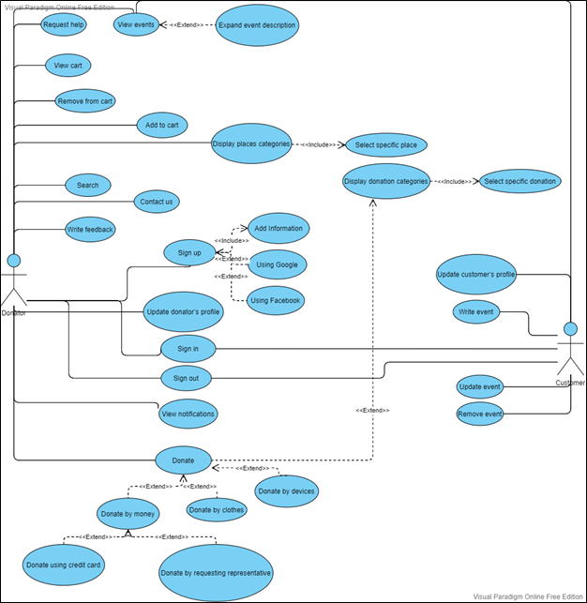
Use-case Diagram

Slide 24
Use-case
Table

Slide 25
Use-case
Table

Slide 26
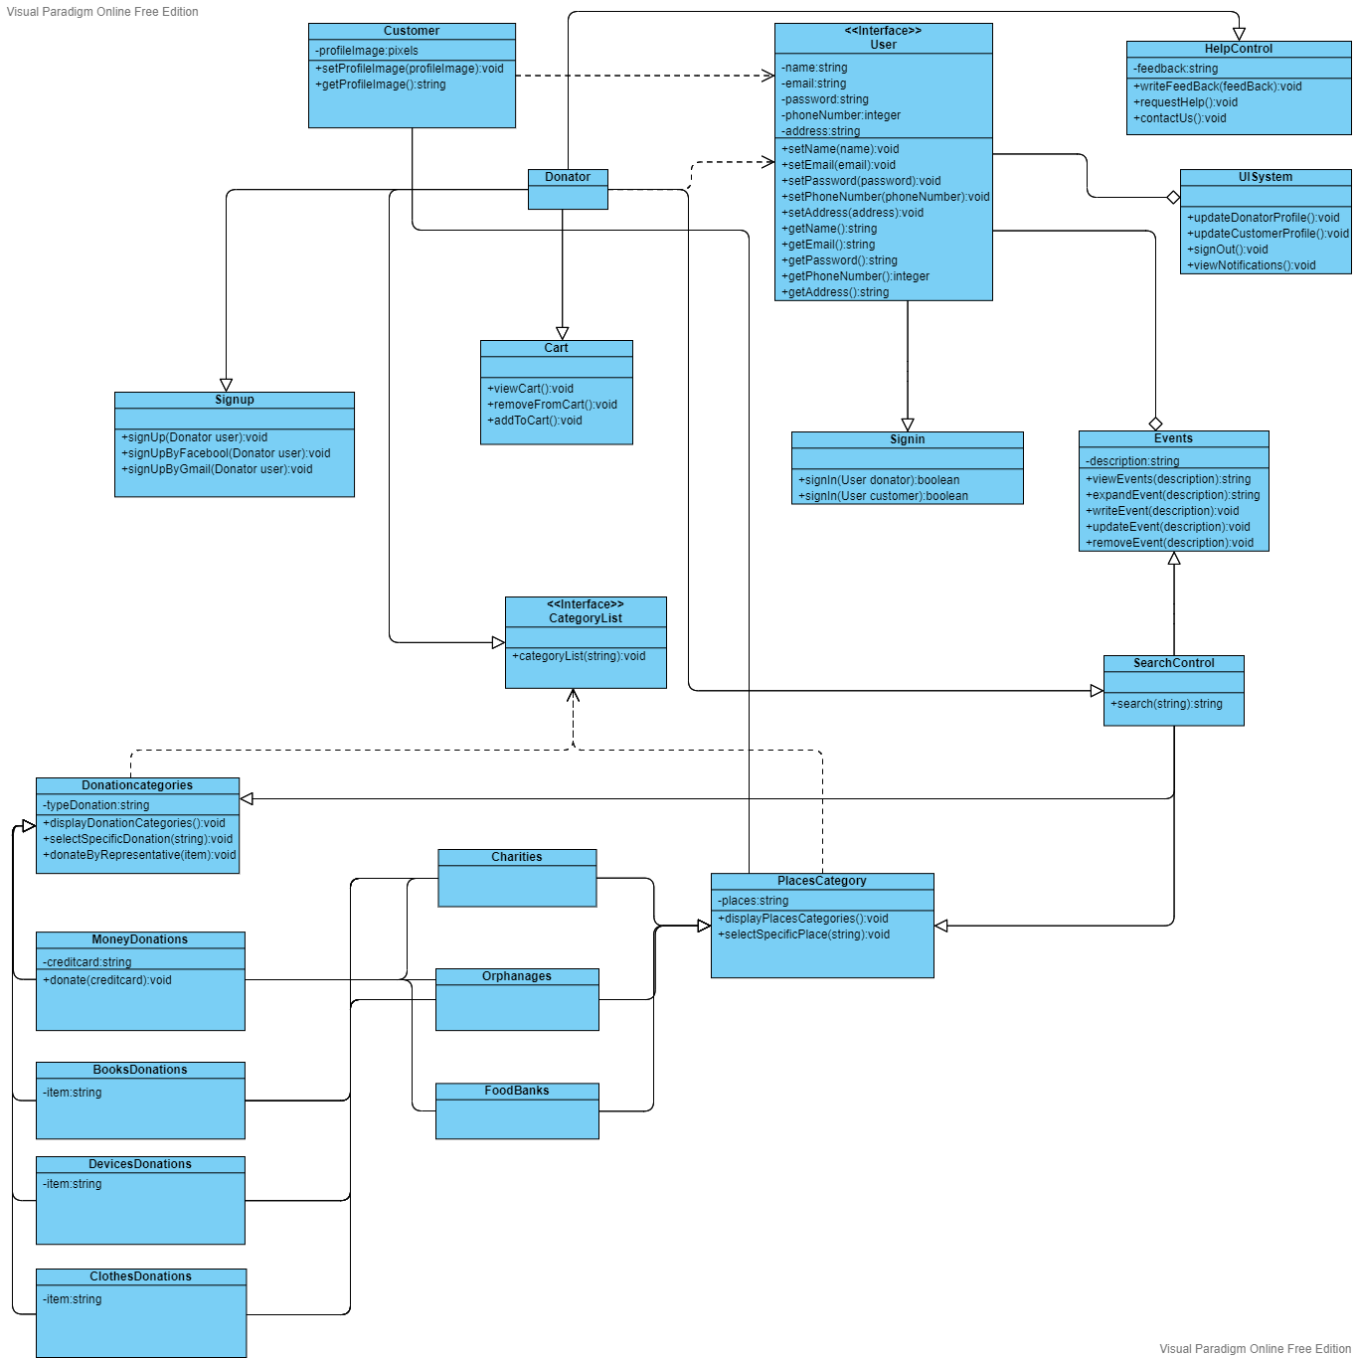
Class Diagram

Slide 27
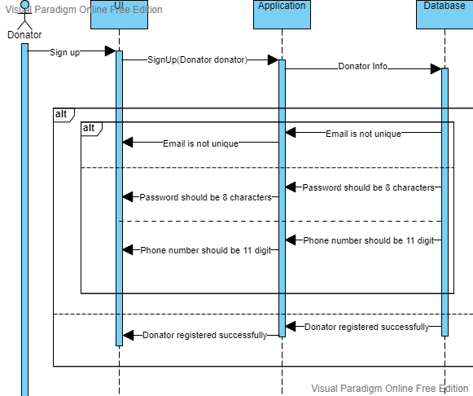
Sequence Diagram 1
Sign up scenario:

Slide 28
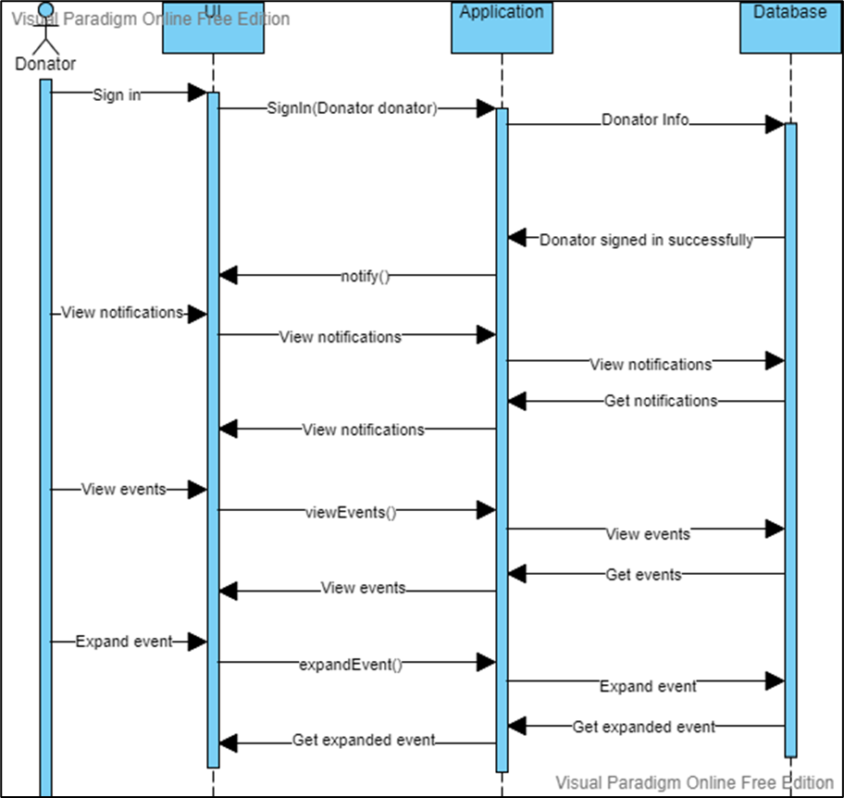
Sequence Diagram 2
Sign in, view notifications, and view events scenarios:

Slide 29
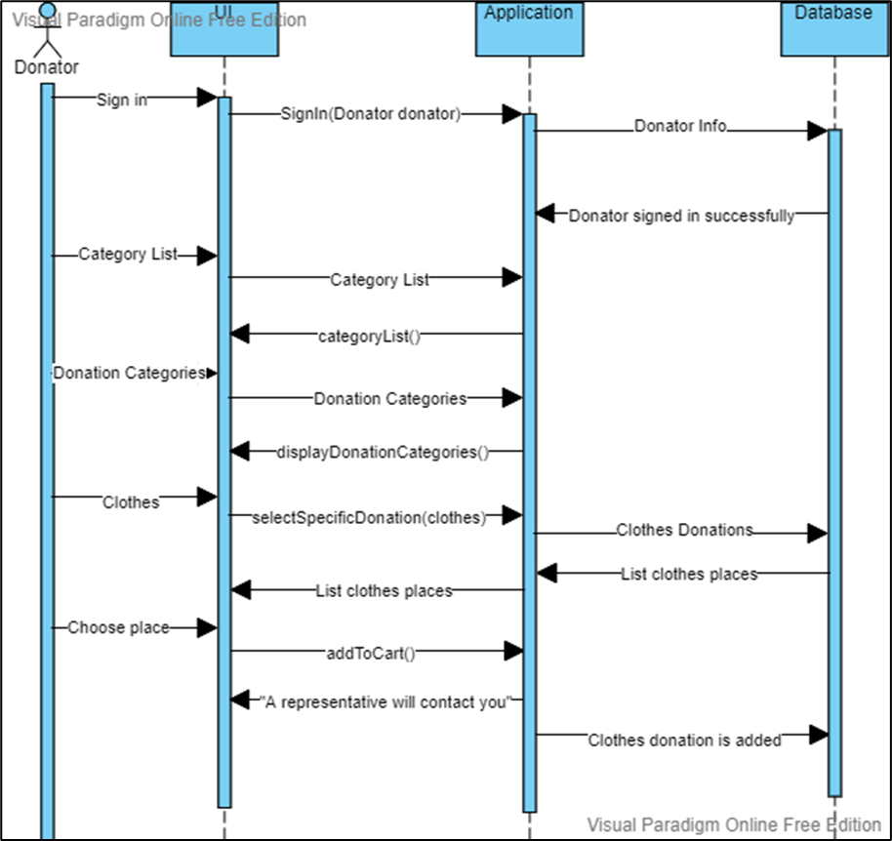
Sequence Diagram 3
Sign in, list category and donation (clothes) scenarios:

Slide 30
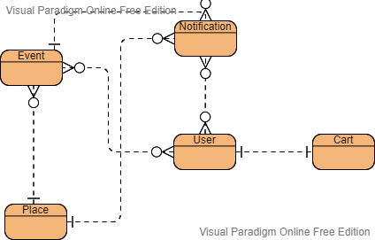
Entity Relationship Diagram (ERD)

Slide 31
TABLE OF CONTENTS
01
02
03
Project idea
Problem significance
Project specifications
Idea description and
domain of interest.
Problems to be solved.
Requirements and important diagrams.
04
05
06
Time Plan
Demo
Conclusion
Tasks to be fulfilled.
Successive screenshots of our application.
Conclusion to what we have said.

Slide 32
04
Time Plan
Tasks to be fulfilled.

Slide 33
Time Plan
Task | Task Title | Task status
1 | Idea brainstorming. | Stared 22/10/2021
2 | Started the documentation. | Started 19/12/2021
3 | 1st requirement trial. | Finished 23/12/2021
4 | Changes in the documentation. | Started 11/2/2022
5 | Finished the diagrams and started doing the logo. | Started 14/2/2022
6 | UI prototyping screens. | Started 15/2/2022
7 | UI prototyping screens + logo. | Started 20/2/2022
8 | Presentation making. | Started 22/2/2022 Finished 24/2/2022
9 | Flutter implementation | Started 8/3/2022
10 | First release | Will be 8/4/2022
11 | Maintenance | Will be 20/4/2022
12 | Second release | Will be 15/6/2022
13 | Final touches in the project | Will be 30/6/2022

Slide 34
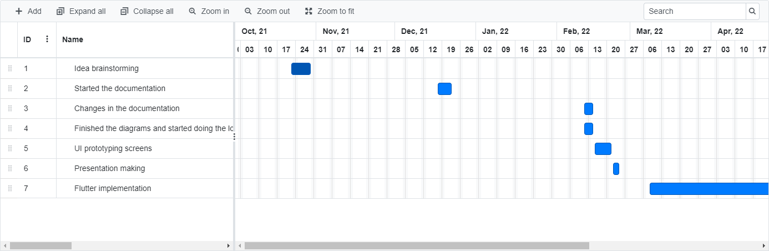
Gantt Chart

Slide 35
TABLE OF CONTENTS
01
02
03
Project idea
Problem significance
Project specifications
Idea description and
domain of interest.
Problems to be solved.
Requirements and important diagrams.
04
05
06
Time Plan
Demo
Conclusion
Tasks to be fulfilled.
Successive screenshots of our application.
Conclusion to what we have said.

Slide 36
05
Demo
Successive screenshots of our application.

Slide 37
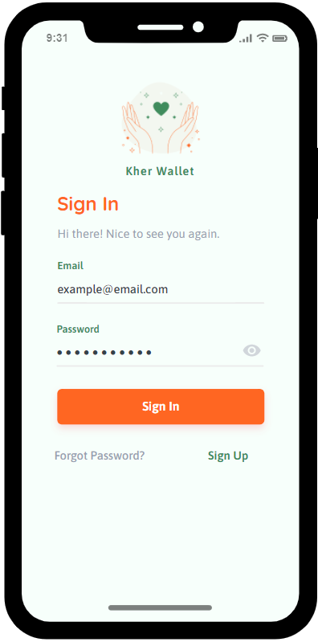
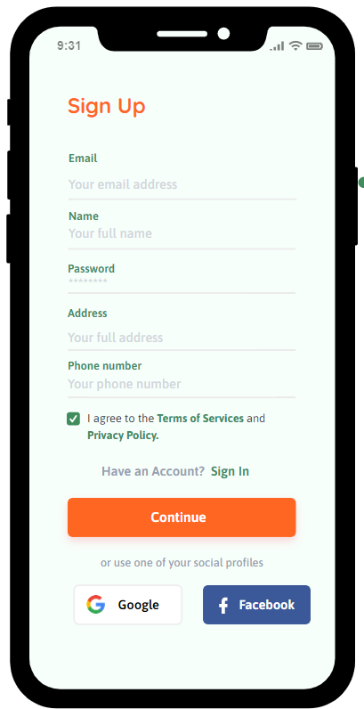
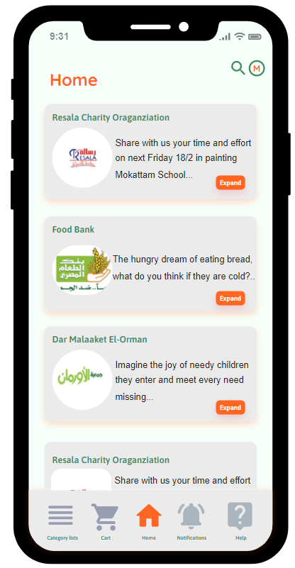
Donator’s demo

Slide 38
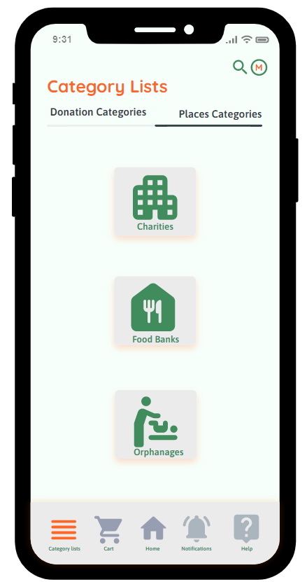
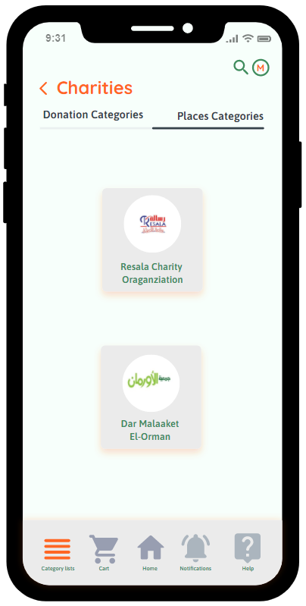
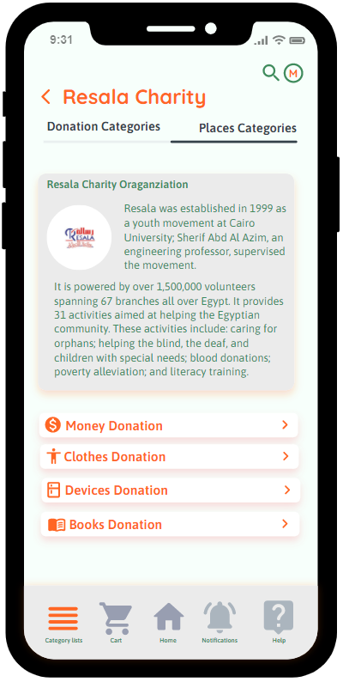
Donator’s demo

Slide 39
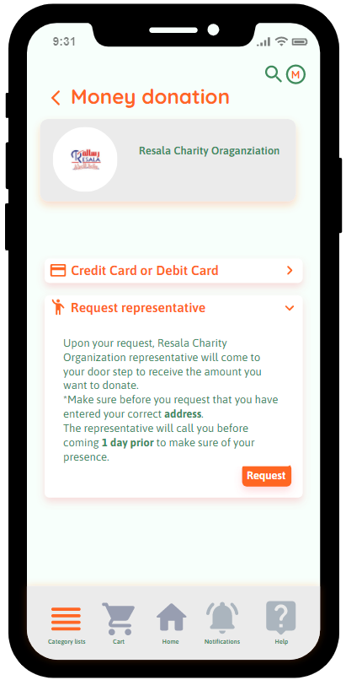
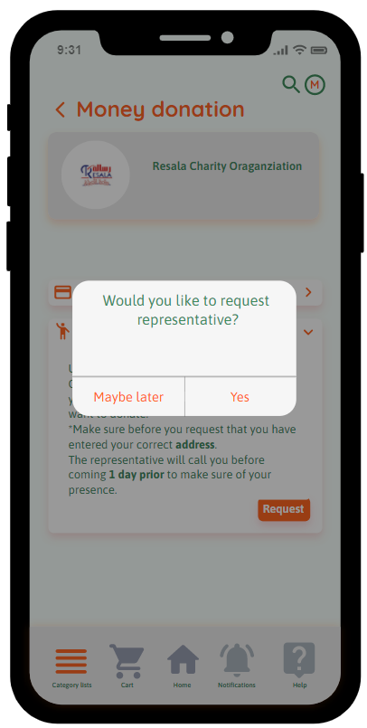
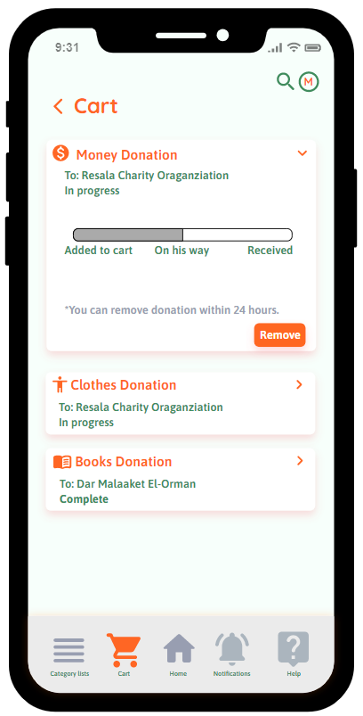
Donator’s demo

Slide 40
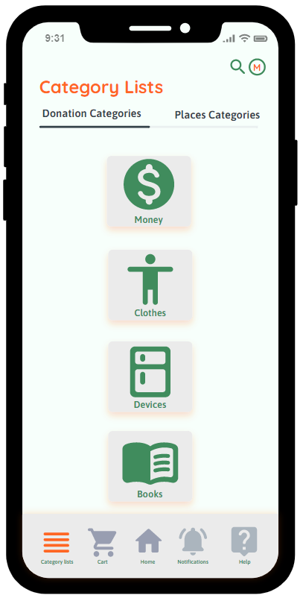
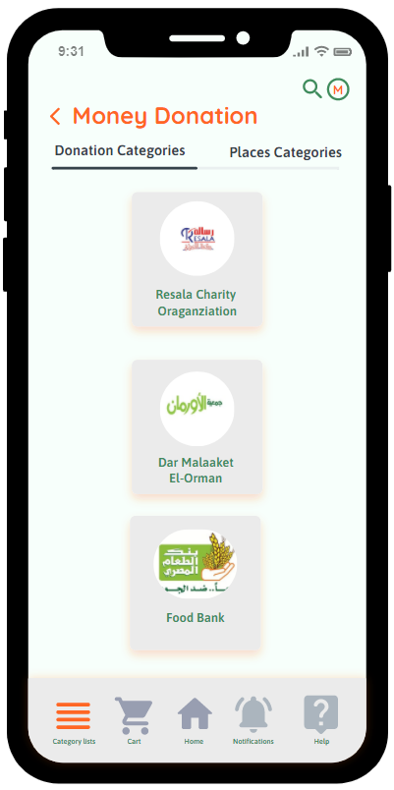
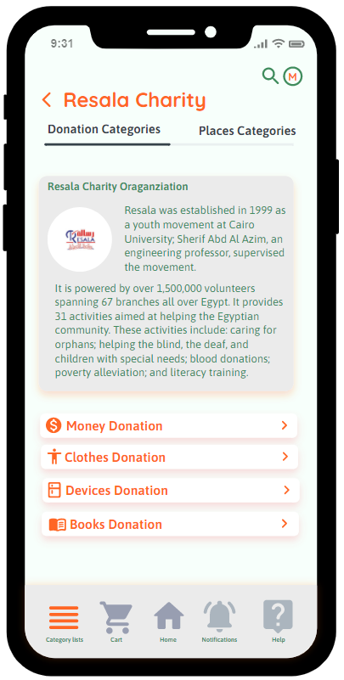
Donator’s demo

Slide 41
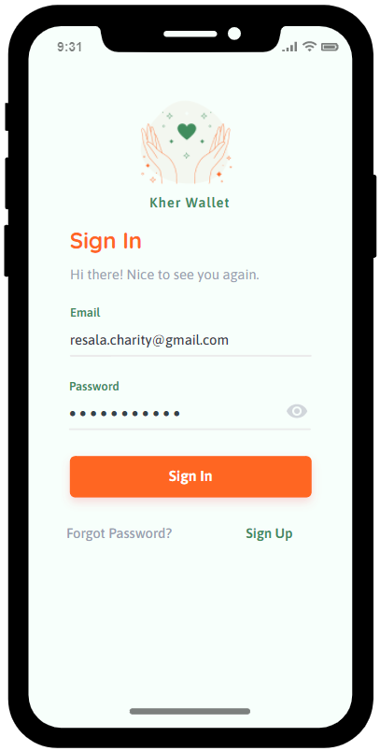
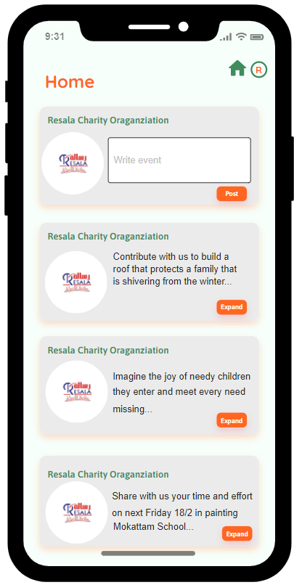
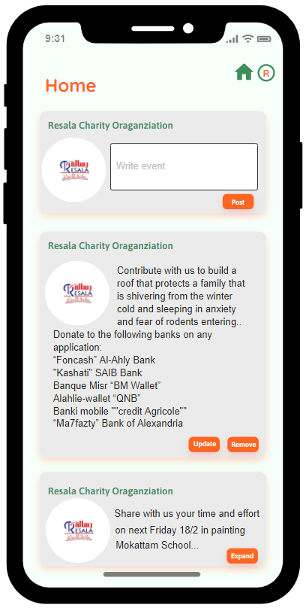
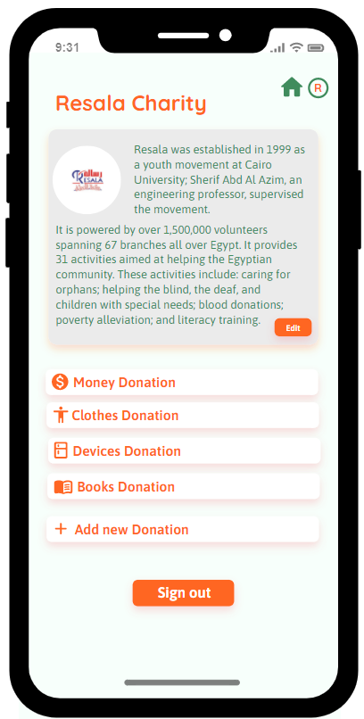
Organization’s demo

Slide 42
TABLE OF CONTENTS
01
02
03
Project idea
Problem significance
Project specifications
Idea description and
domain of interest.
Problems to be solved.
Requirements and important diagrams.
04
05
06
Time Plan
Demo
Conclusion
Tasks to be fulfilled.
Successive screenshots of our application.
Conclusion to what we have said.

Slide 43
06
Conclusion
Conclusion to what we have said.

Slide 44

THANKS!
Do you have any questions?
kherwallet@gmail.com

